Slide 1
Disk Operating System
Binup KC

Slide 2
What is DOS?
DOS stands for Disk Operating System.
the first widely installed operating system for personal computers.
designed to operate on machines using the Intel line of 8086 microprocessors
Single user, single tasking system
Kernel Functions are non-reentrant (only one program at a time can use them)
DOS controls the computer’s hardware and provides an environment for programs to run.
Provides services for basic input/output services (BIOS), print services, and file services.

Slide 3
MS-DOS cannot support a large network of users.
preferred operating system for most of the Intel processor (currently Pentium) based PCs of the world.
Closely related to UNIX and CP/M.
interact more directly with the components of the computer than you can with more modern operating systems.
do things which are difficult or impossible to accomplish through the graphical interface.

Slide 4
History of DOS
The CP/M
IBM/PC hiring Microsoft
Microsoft hiring Seattle
QDOS(Quick and Dirty Operating System)
Microsoft’s acquisition of DOS
Ms-DOS

Slide 5
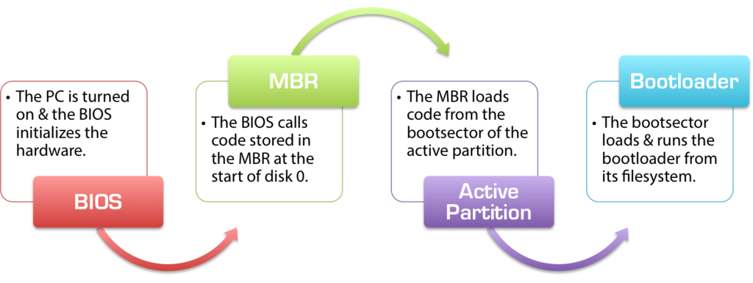
DOS Boot Sequence

Slide 6
DOS Kernel
two hidden files at boot time:
io.sys : default device drivers
msdos.sys : system file, comprises DOS kernel
load at the time of startup
are not rebuildable or alterable
kernel cannot be changed
Command.com: starts the command processor

Slide 7
DOS Batch language
.BAT extension
executable by the command processor
support conditional statements and variables (eg, if time = next_day then...).

Slide 8
System Configuration in DOS
How the system is configured in DOS
What functions are loaded in startup
Device drivers
Startup Programs

Slide 9
CONFIG.SYS
loading installable device drivers
other system parameters which must run at boot time

Slide 10
AUTOEXEC.BAT
starts applications automatically for the user
handles logins for network software
places information in the PC’s environment

Slide 11
DOS Commands
DOS consist of a series of a program designed to control the computer resources.
DOS commands have three parts: File name, parameters, switches.
Mostly these commands consist of regular English word like words.
For example ERASE,COPY,DEL,PRINT etc.
Types:
Internal
External

Slide 12
DOS Internal Commands
DOS internal commands are stored in the COMMAND.COM file.
DOS internal command are loaded automatically into the memory (RAM) when you start your systems.
These includes the simpler and common commands that are needed on regular basis.
Internal commands are the part of COMMAND.COM
Some DOS internal command are:
CLS –clear the screen.
VER – Display the DOS version number.
VOL –Displays the volume label and serial.
TYPE –Display the contents of a text .
Exit –Exit the command processor

Slide 13
DOS External Commands
Second type of DOS Commands is External command.
DOS External Command required less frequently.
These are reside on disk.
Loaded automatically into memory (RAM) only when needed.
Some DOS External Commands are:-
CHKDSK – Check the validity of disk and reports the total space, number of files and amount of free space.
COMP – Compare the content of two sets of files.
COMMAND – Starts the command processor.
SYS –Creates a bootable drive.

Slide 14
Major Tasks of DOS
The major tasks the DOS must carry out are:-
Manage I/O
reads input from the standard input
writes output to the standard output
treats devices as files
output of a command or program canbe piped to another command or program
File Management
requires only a pointer to the data buffer, and a count of the number of bytes to be read or written in order to do I/O
Executable files: .COM format or the .EXE format
To enable user to load and execute program.
To maintain an orderly system of data on the disk.

Slide 15
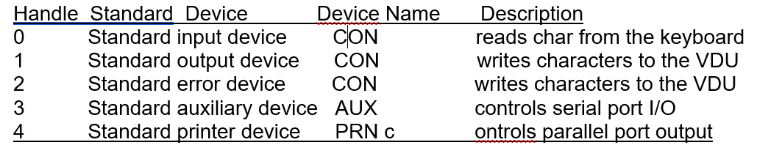
File Management
maintains a table that relates handles to files or devices.
This table is in CONFIG.SYS file

Slide 16
File System
Uses File Allocation Table (FAT) system.
Originally FAT12 (4078 clusters per drive) => FAT16 (65518 clusters per drive) => FAT32 (137GB and beyond)
Reduce amount of seeking
Designed to support hard drives
Four sections: Boot Sector, FAT region, Data region, Root Directory region.
Diminish wear and tear of hard drive
8.3 filenames: (8 letter filename, 3 letters extension)
Starting with DOS 2 hierarchical directories are supported.
Reserved filenames: CON (for console), AUX (for auxiliary), PRN[36] (for printer) and LST (for lister)

Slide 17
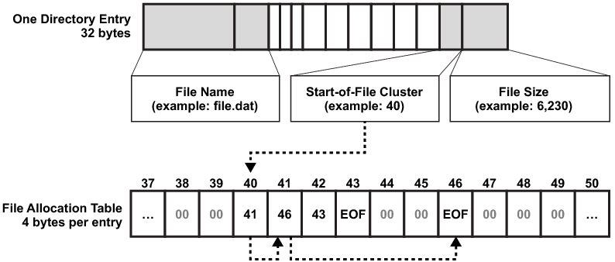
File Allocation Table

Slide 18
DOS files
BAT (batch files):
consist of series of command to be executed by compiled line interpreter, stored in plain text
branching and looping within the file ,such as IF, FOR, GOTO and LABEL.
COM (command files):
It consist of collection of internal and external command.
EXE (executable files):
It is the file that the computer can directly execute.

Slide 19
Disk Management
drives are referred to by identifying letters
A" and "B" for floppy drives
Hard drives were originally assigned the letters "C" and "D“
only support one active partition per drive
Assign drive letter to each drive's active primary partition first
then make a second pass over the drives to allocate letters to logical drives in the extended partition.
Lastly, DOS allocates letters for optical disc drives, RAM disks, and other hardware

Slide 20
Graphical Capabilities
Make use of GRAPHICS command
Syntax:
GRAPHICS [printer type][profile] [/B][/R][/LCD][/PB:(id)] [/C][/F][/P(port)]
Direct interface with display hardware
Libraries were rare
Languages used: C, PASCAL, Assembly

Slide 21
Memory Management
could only directly access a maximum of 1 MB of RAM
maximum of 640 KB (known as conventional memory) is available as the upper 384 KB is reserved
Memory areas
Conventional Memory
Upper Memory Area
Expanded Memory

Slide 22
Memory management
Memory Organization:
i. Interrupt vector table
ii. Optional extra space (used by IBM for ROM data area
iii. IO.SYS
iv. MSDOS.SYS
v. Buffers, control areas, and installed device drivers
vi. Resident part of COMMAND.COM
vii. External commands or utilities (.COM and .EXE files are loaded here)
viii. User stack for .COM Files (256 bytes)
ix. Transient part of COMMAND.COM

Slide 23
DOS Emulators
DOSBox
MAME
NeoRage (X)

Slide 24
THANK YOU!

